Slide 1
EECS 490 – Lecture 5 Grammars

Slide 2
Announcements
Project 1 due Thursday 9/21 at 8pm
Homework 2 due Friday 9/29 at 8pm

Slide 3
Review: Levels of Description
Grammar: what phrases are correct
Lexical structure: what sequences of symbols represent correct words
Syntax: what sequences of words represent correct phrases
Semantics: what does a correct phrase mean
Pragmatics: how do we use a meaningful phrase
Implementation: how are the actions specified by a meaningful phrase accomplished
Notes:
The first three concepts are derived from linguistics, the last is an artifact of programming languages.

Slide 4
Agenda
Regular Expressions
Context-Free Grammars

Slide 5
Regular Expression
Sequence of characters that define a pattern for matching strings
Components:
Empty string: ε
Individual characters from an alphabet: a, b
Concatenation: ab
Alternation or choice: a|b
Kleene star, zero or more occurrences of an element: a*
Precedence: Kleene star > concatenation > alternation
Parentheses used for disambiguation

Slide 6
RegEx Examples
a|b — matches only the strings a and b
a*b — matches any number of a's followed by a b
b, ab, aab
(a|b)* — any number of a's and b's
ε, a, b, aa, ab, ba, bb, aaa
ab*(c|ε) — an a, followed by any number of b's, followed by an optional c
a, ac, ab, abc, abb, abbc

Slide 7
Shorthands
Many systems provide shorthands for common cases
Question mark: zero or one occurrence
ab*(c|ε) == ab*c?
Plus sign: one or more occurrences
a+b matches ab, aab, but not b
Square brackets: set of characters
[abc] == (a|b)|c
Character ranges
[a-d] == [abcd]

Slide 8
Identifiers
RegEx to match identifiers and keywords in C-like language [a-zA-Z_][a-zA-Z_0-9]*
An identifier or keyword starts with a letter or underscore, followed by any number of letters, digits, and underscores
Examples: _, x, int, static_cast, L337

Slide 9
RegEx Limitations
Regular expressions are powerful, but cannot express many syntax rules
Example: a^{n}b^{n}, i.e. any number of a's followed by the same number of b's
ε, ab, aabb, aaabbb
Example: matching parentheses
(), ()(), (()), (()())

Slide 10
Agenda
Regular Expressions
Context-Free Grammars

Slide 11
Context-Free Grammar
Defines a recursive process for matching a string
Terminals: symbols from a language
Example: ε, a, b
Variables: items that can be replaced with other variables or terminals
Example: S
Production rules: legal ways to replace variables with other variables or terminals
Example: S → ε, S → a S b
Start variable: where to start the replacement process
Example: S

Slide 12
Derivations
Sequence of rule applications, starting with the start variable and ending with a string of terminals
CFG:
S → ε
S → a S b
String that can be derived from CFG: S → a S b by application of rule (2) → a a S b b by application of rule (2) → a a b b by application of rule (1)
The CFG matches strings containing any number of a's, followed by the same number of b's

Slide 13
Matching Parentheses
CFG:
P → ε
P → ( P )
P → P P
Derivation of (()): P → ( P ) by application of rule (2) → ( ( P ) ) by application of rule (2) → ( ( ) ) by application of rule (1)

Slide 14
Alternate Derivations
P → ε
P → ( P )
P → P P
Derivations of ()() P → P P by application of rule (3) → ( P ) P by application of rule (2) on 1st P → ( ) P by application of rule (1) → ( ) ( P ) by application of rule (2) → ( ) ( ) by application of rule (1) P → P P by application of rule (3) → P ( P ) by application of rule (2) on 2nd P → P ( ) by application of rule (1) → ( P ) ( ) by application of rule (2) → ( ) ( ) by application of rule (1)
Not a problem if derivation trees are identical

Slide 15
Derivation Trees
P → P P → ( P ) P → ( ) P → ( ) ( P ) → ( ) ( )
P
P
P
P
P
P
P
P
P
P
(
P
)
(
P
)
In-order traversal is derived string
ε
P
P
P
P
P
P
(
P
)
(
P
)
(
P
)
(
P
)
ε
ε
ε
Notes:
Use to construct abstract syntax trees in interpreters/compilers.

Slide 16
Derivation Trees
P → P P → P ( P ) → P ( ) → ( P ) ( ) → ( ) ( )
P
P
P
P
P
P
P
P
P
P
(
P
)
(
P
)
ε
ε
Same tree
P
P
P
P
P
P
(
P
)
(
P
)
(
P
)
(
P
)
ε
ε
ε

Slide 17
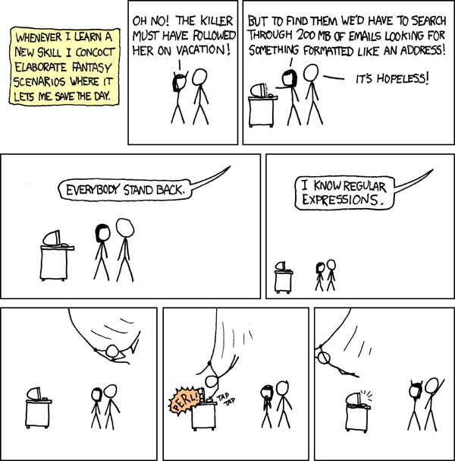
Break Time!

Slide 18
Break Time!
We’ll start again in one minute.

Slide 19
Arithmetic Grammar
E → E + E
E → E * E
E → a
E → b
Derivations of a + b * a E → E + E by rule (1) → E + E * E by rule (2) on 2nd E → a + E * E by rule (3) on 1st E → a + b * E by rule (4) on 1st E → a + b * a by rule (3) E → E * E by rule (2) → E + E * E by rule (1) on 1st E → a + E * E by rule (3) on 1st E → a + b * E by rule (4) on 1st E → a + b * a by rule (3)

Slide 20
Ambiguity
E → E + E
E → E * E
E → a
E → b
Grammar is ambiguous since the different derivations result in different trees E → E + E by rule (1) → E + E * E by rule (2) on 2nd E → a + E * E by rule (3) on 1st E → a + b * E by rule (4) on 1st E → a + b * a by rule (3) E → E * E by rule (2) → E + E * E by rule (1) on 1st E → a + E * E by rule (3) on 1st E → a + b * E by rule (4) on 1st E → a + b * a by rule (3)
First tree corresponds to * having higher precedence
Usually resolved by specifying precedence rules.
E
E
+
E
a
E
*
E
b
a
E
E
*
E
E
+
E
a
a
b

Slide 21
Extended Backus-Naur Form
Grammars for programming languages are generally written in an extended Backus-Naur form (EBNF)
Includes representation of production rules in a more limited character set
e.g. E := E + E instead of E → E + E
Adds shorthands like in regular expressions
e.g. Kleene star, alternation with | rather than separate production rules
Language-specific extensions
e.g. "except", "one of" in Java grammar

Slide 22
Identifiers
Identifiers in a C-like language described using Java's EBNF Identifier: except Keyword and BooleanLiteral IdentifierStartCharacter IdentifierStartCharacter IdentifierCharacters IdentifierStartCharacter: _ LowerCaseLetter UpperCaseLetter IdentifierCharacters: IdentifierCharacter IdentifierCharacters IdentifierCharacter IdentifierCharacter: IdentifierStartCharacter Digit LowerCaseLetter: one of a b c d e f g h i j k l m n o p q r s t u v w x y z UpperCaseLetter: one of A B C D E F G H I J K L M N O P Q R S T U V W X Y Z Digit: one of 0 1 2 3 4 5 6 7 8 9
Alternation on separate lines
Also alternation

Slide 23
C-Style Comments in Java
Need to ensure that */ ends a comment, as well as **/, ***/, etc. TraditionalComment: / * CommentTail CommentTail: * CommentTailStar NotStar CommentTail CommentTailStar: / * CommentTailStar NotStarNotSlash CommentTail NotStar: InputCharacter but not * LineTerminator NotStarNotSlash: InputCharacter but not * or / LineTerminator

Slide 24
Scheme Lists
From R5RS spec: ⟨list⟩ → (⟨datum⟩*) | (⟨datum⟩+ . ⟨datum⟩) | ⟨abbreviation⟩ ⟨abbreviation⟩ → ⟨abbrev prefix⟩ ⟨datum⟩ ⟨abbrevprefix⟩ → ’|‘|,|,@
List can be
Zero or more datums in parentheses
Parentheses containing one or more datums, a period, and a single datum
A quotation character followed by a datum

Slide 25
Vexing Parse
In languages with complex syntax, such as C++, ambiguity cannot be avoided in the grammar
External rules are specified to disambiguate fragments
struct foo { foo() { cout << "foo::foo()" << endl; } foo(int x) { cout << "foo::foo(" << x << ")" << endl; } void operator=(int x) { cout << "foo::operator=(" << x << ")" << endl; } }; int a = 3, b = 4; int main() { foo(a); // equivalent to foo a; foo(b) = 3; // equivalent to foo b = 3; }
C++ disambiguates in favor of declarations
Names can be parenthesized in declarations
foo::foo()
foo::foo(3)

Slide 26
Most Vexing Parse
A most vexing example: struct bar { bar(foo f) { cout << "bar::bar(foo)" << endl; } }; bar c(foo()); // equivalent to bar c(foo);
Clang warning:
Nothing printed
C++ disambiguates in favor of function declarations
foo.cpp:28:8: warning: parentheses were disambiguated as a function declaration
[-Wvexing-parse]
bar c(foo()); // equivalent to bar c(foo);
^~~~~~~
foo.cpp:28:9: note: add a pair of parentheses to declare a variable
bar c(foo()); // equivalent to bar c(foo);
^
( )

